Slide 1
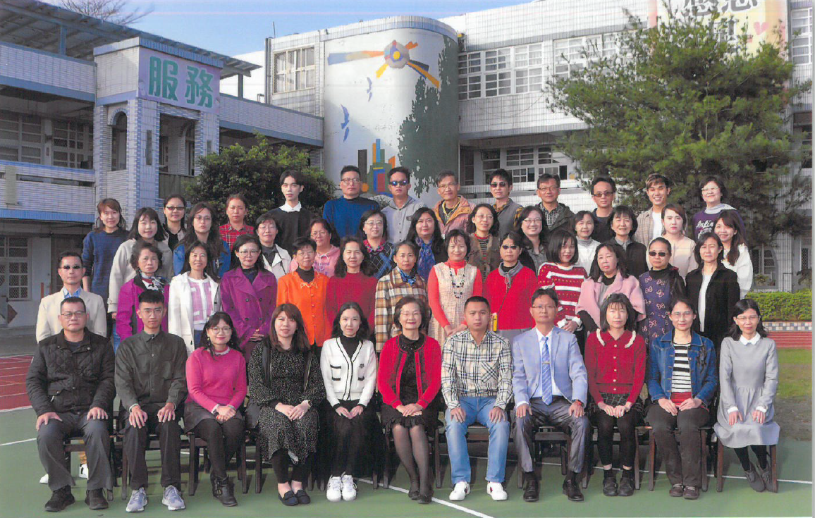
Sister School Proposal
FENYUAN ELEMENTARY SCHOOL (FYPS)

Slide 2
This sister school proposal for English-speaking countries consists of the overview of the FYPS demographics, school features, MOU prospective, and school contact window.
Your consideration will be highly appreciated.
No. 48, Ln. 27, Sec. 4, Zhangnan Rd., Fenyuan Township, Changhua County 502 , Taiwan (R.O.C.)

Slide 3
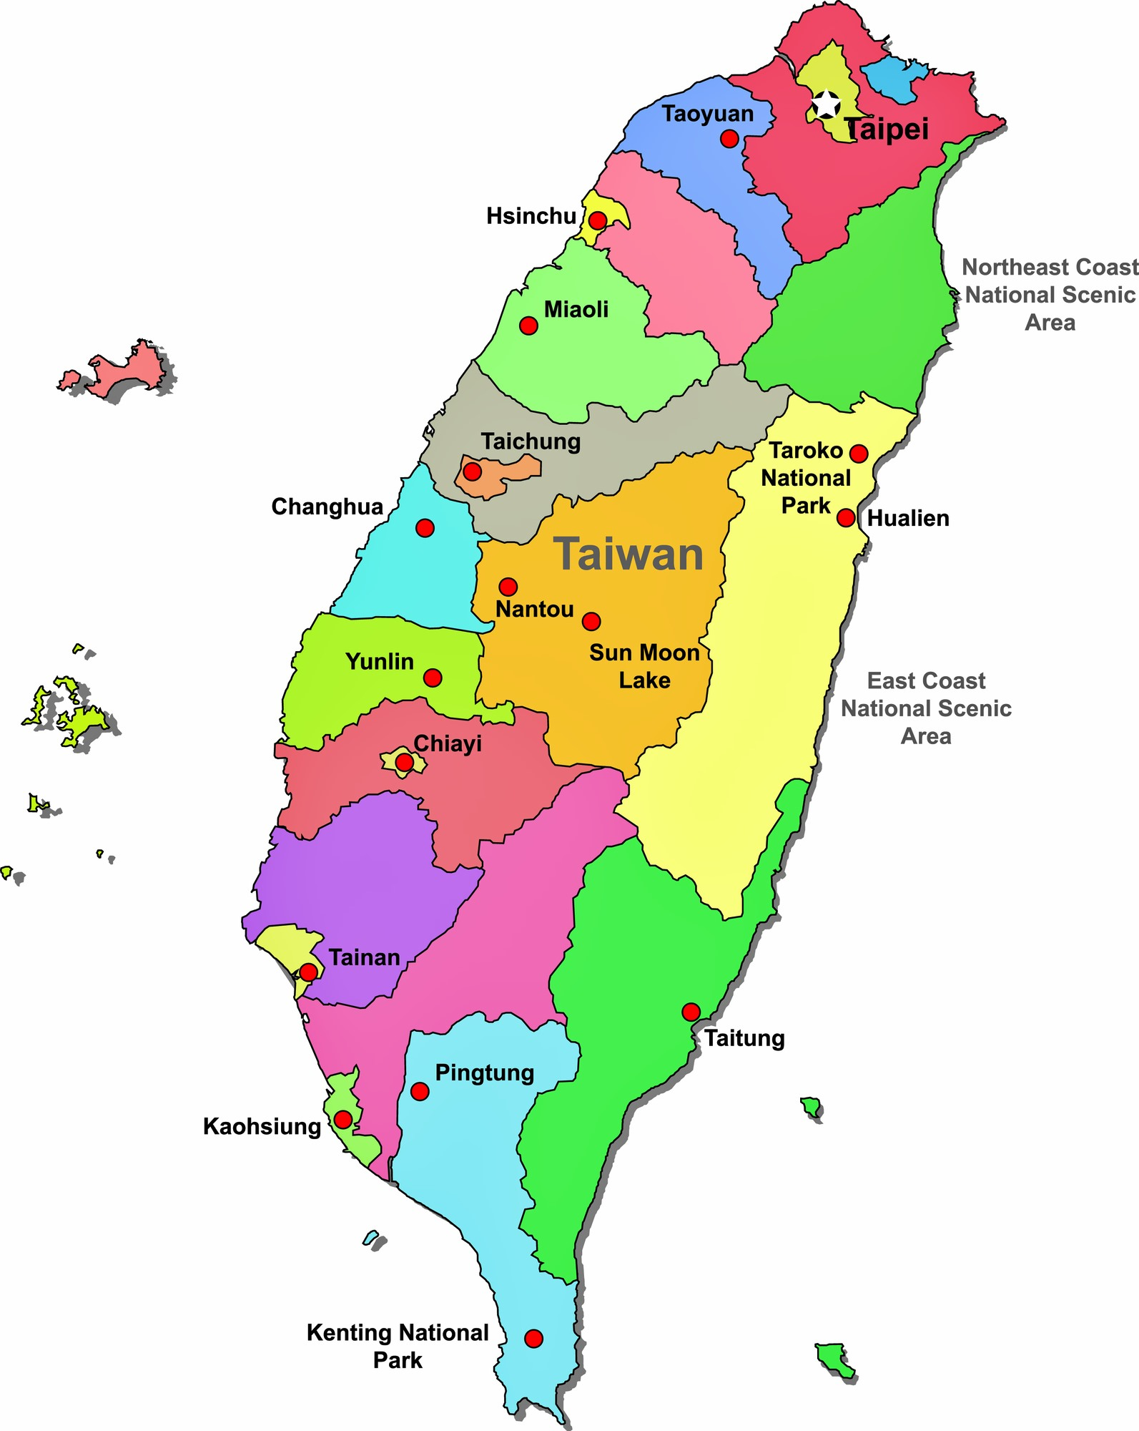
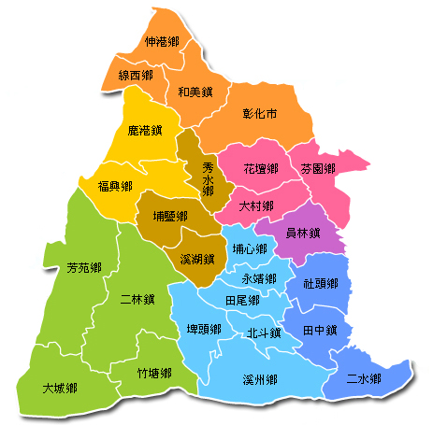
Fenyuan is a small township of Changhua county in Taiwan
Location
Fenyuan
芬園鄉
Changhua
彰化縣

Slide 4
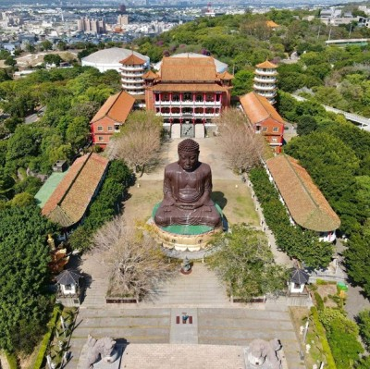
Must visit spots in Changhua
Old street in Lukang, a cultural township
Landmark of Changhua City: Great Budda

Slide 5
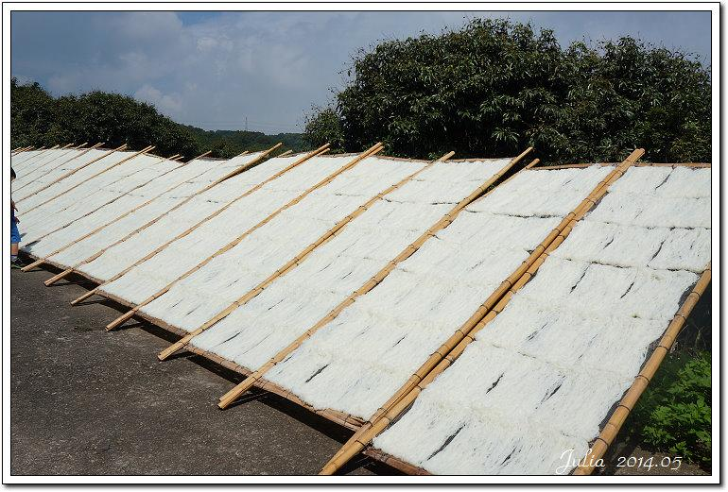
芬園三寶 3 specialties in Fenyuan
荔枝 litchi
米粉 rice noodles
鳳梨 pineapple

Slide 6
About Fenyuan
Fen-Yuan
elementary
kindergarten
18 classes
377 students
40 teachers
1
class
30 students
3 teachers

Slide 7
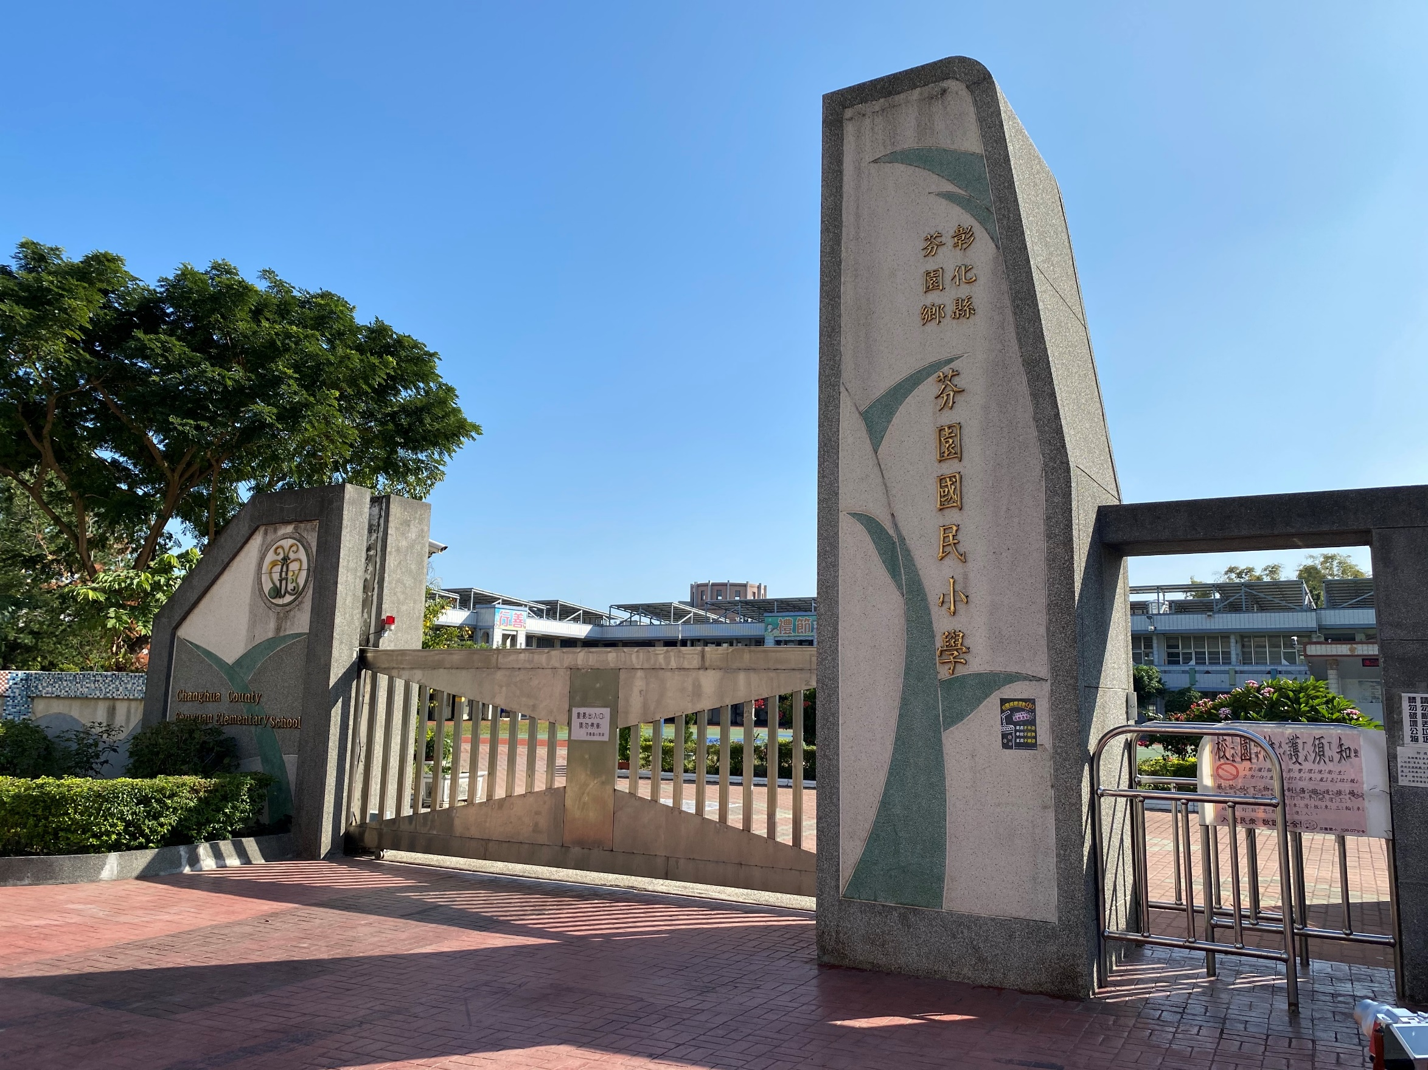
School Gate

Slide 8
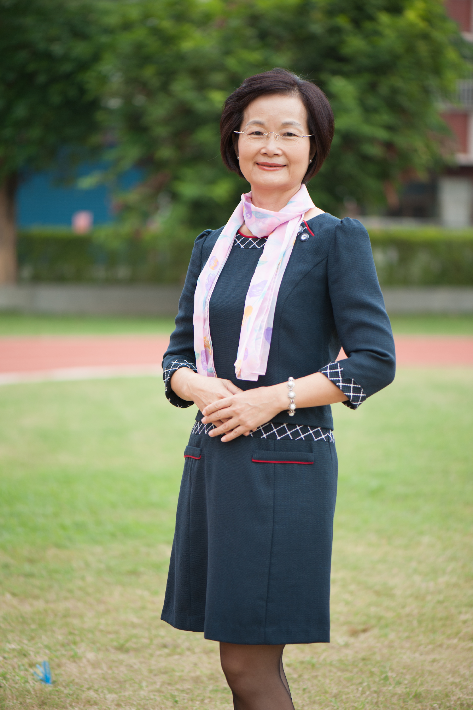
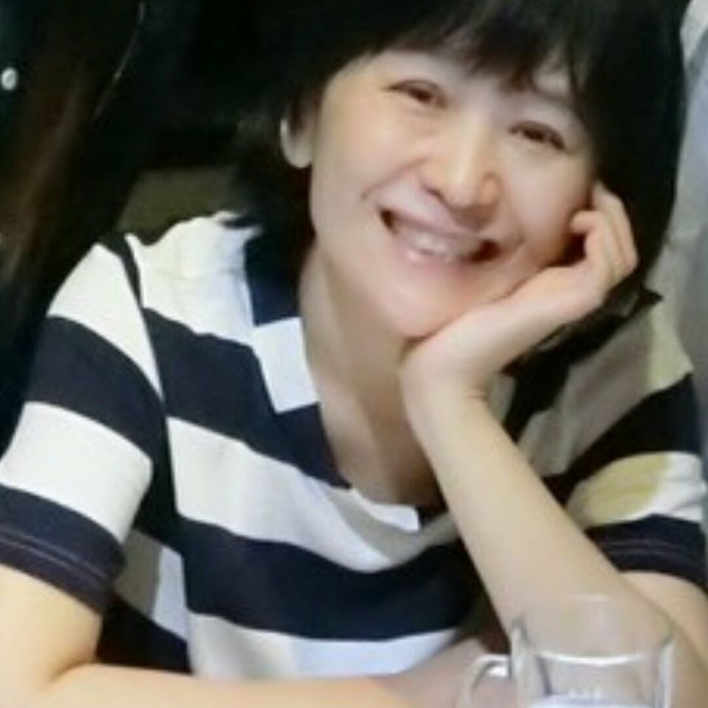
Meet our facluty
Principal
Director of Academic Affairs
Iris Wang
English Teacher
Karen Chung
Yinhsueh Chiang

Slide 9
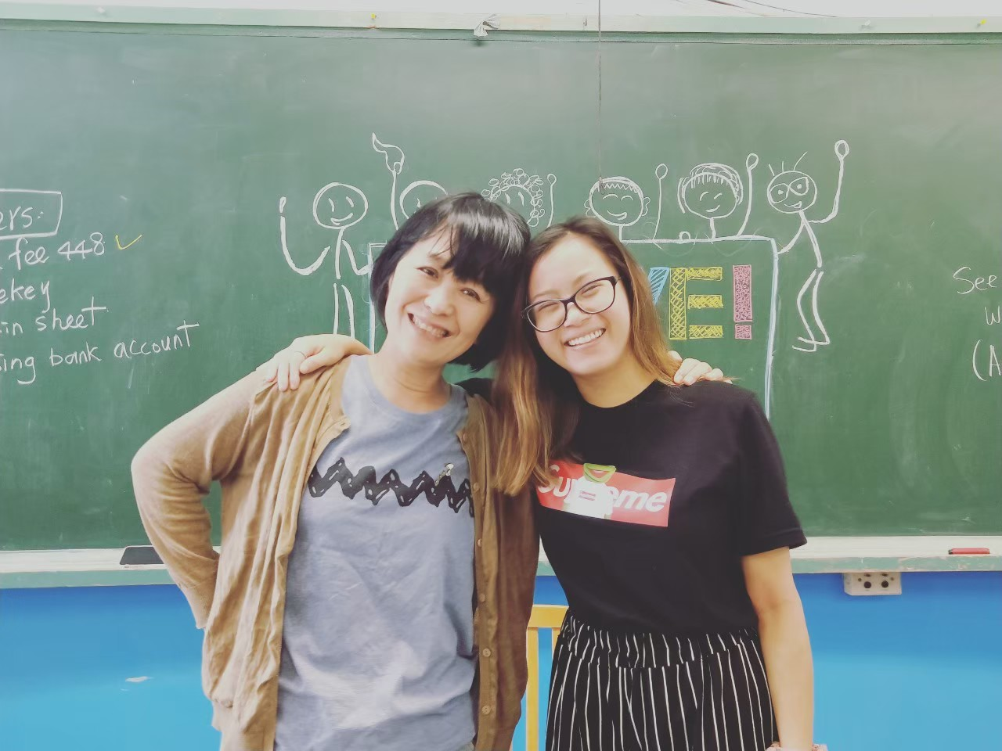
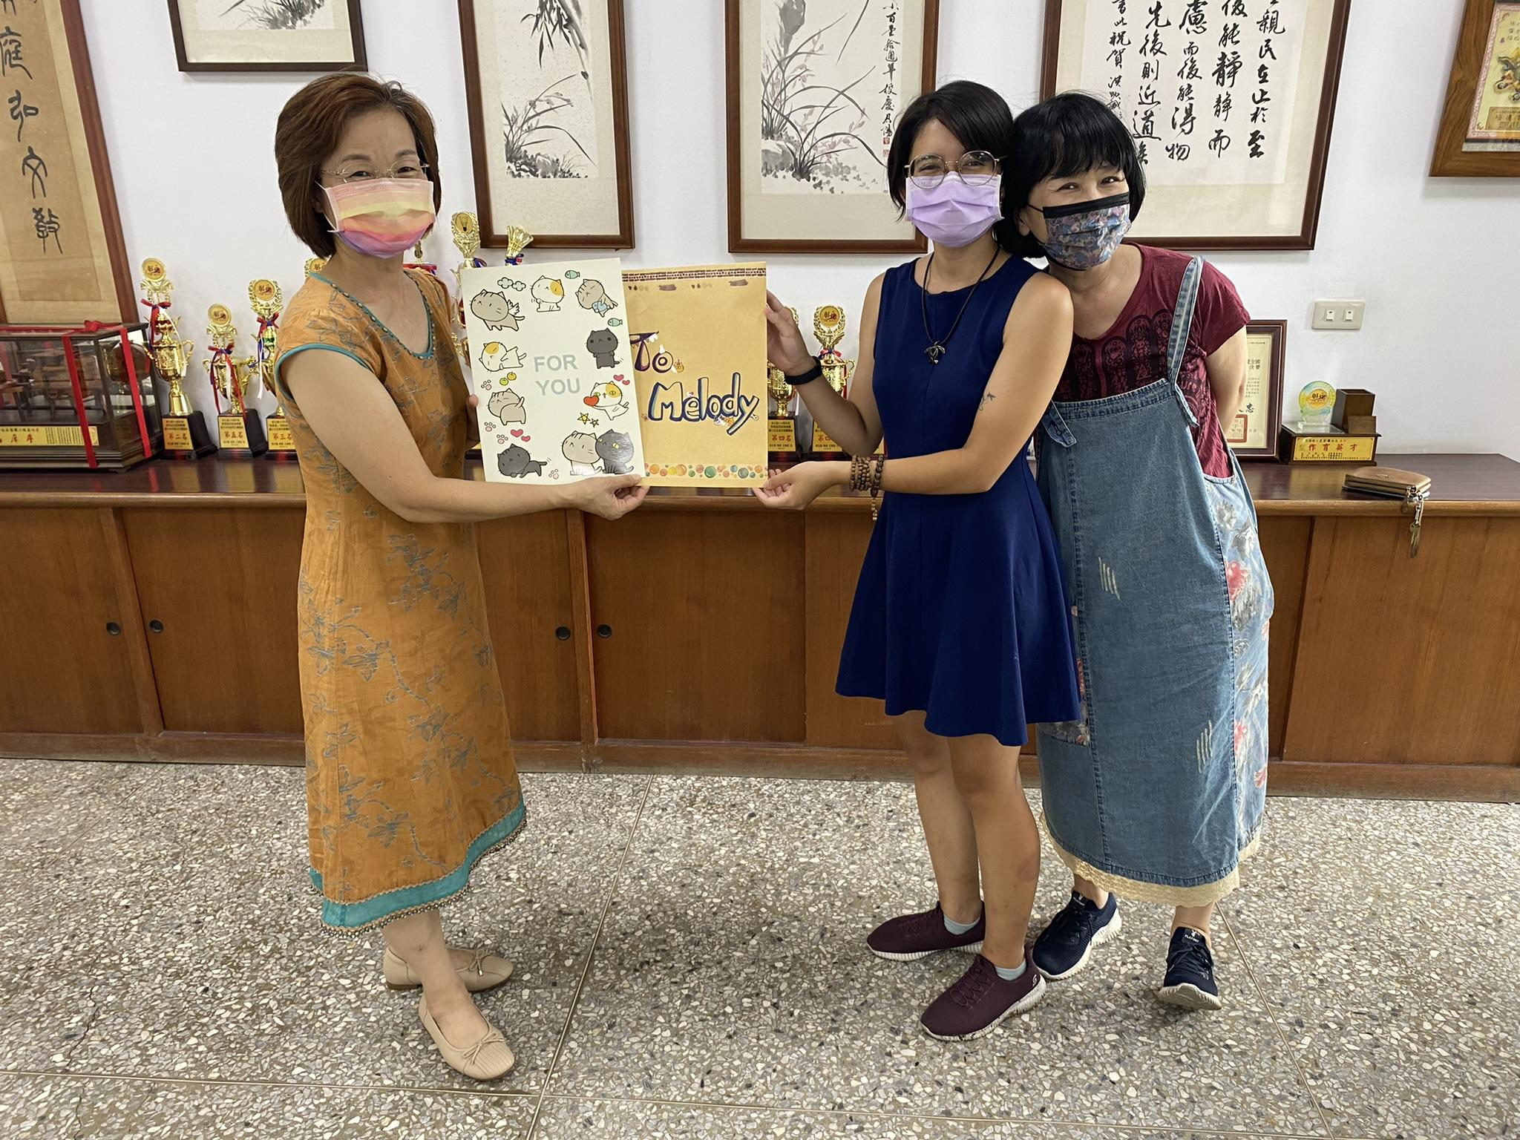

Slide 10
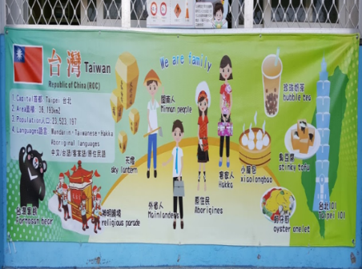
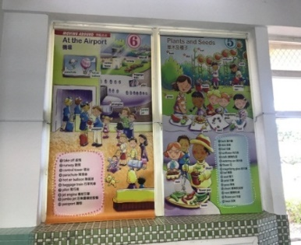
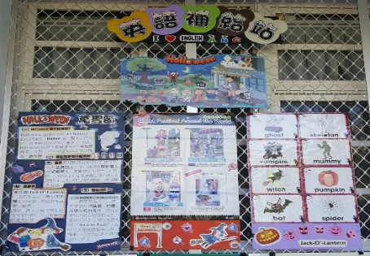
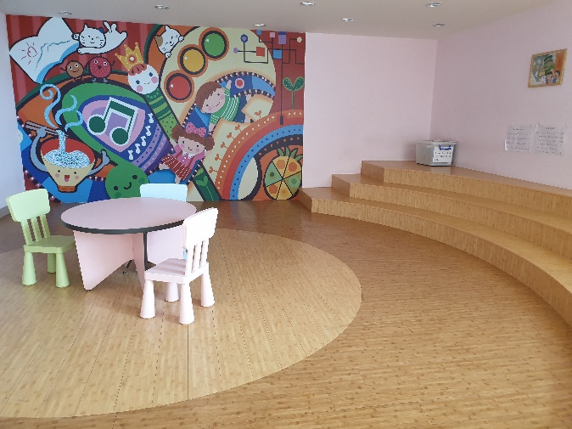
Creating Learning Environment
Countries Posters on the Walls | English Roller Blinds in the classroom
English Corner | Multifunctional Library

Slide 11
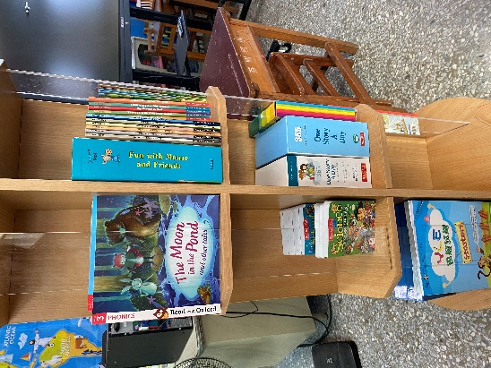
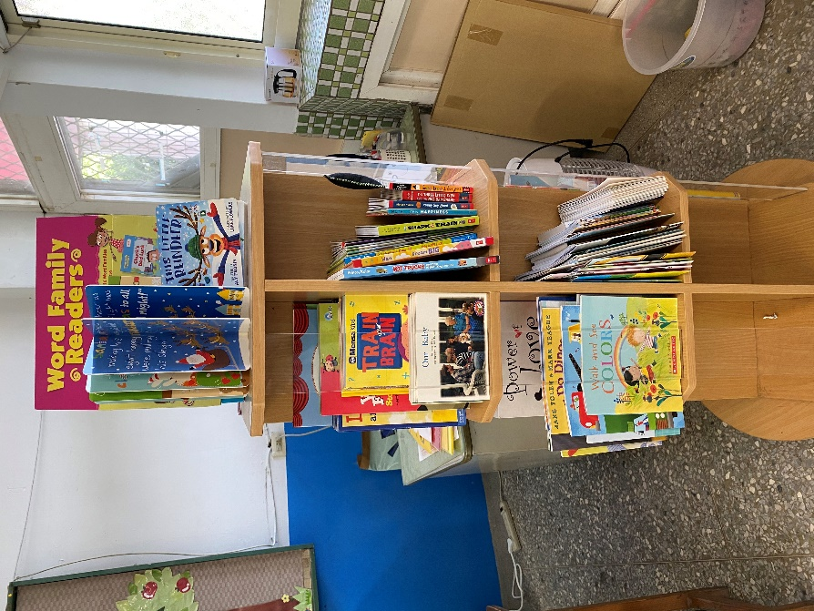
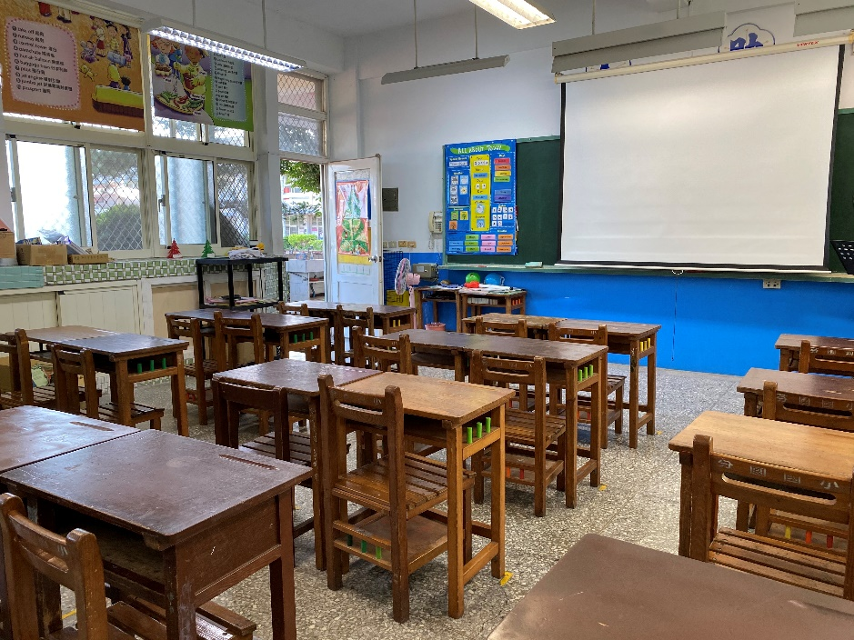
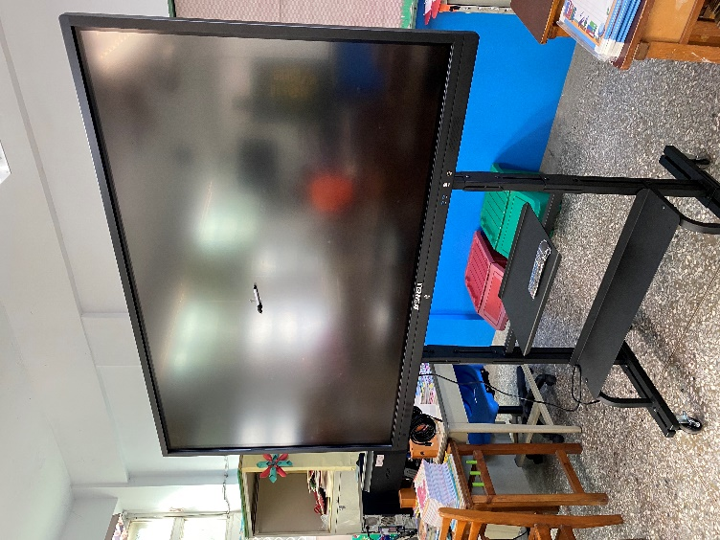
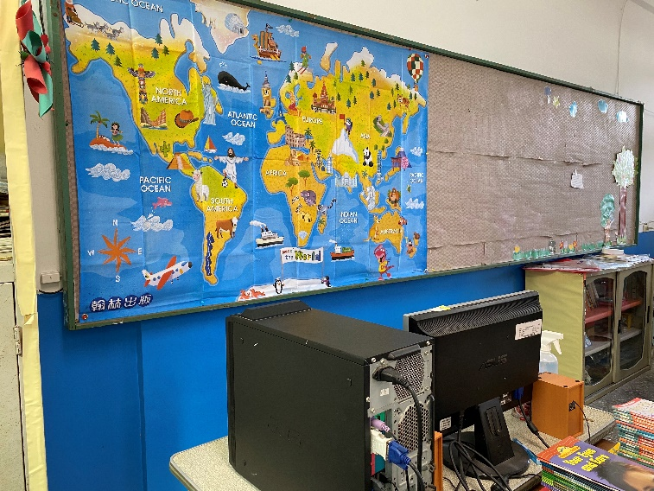
the Classroom
Mini Library in Classroom
World map in classroom
Touch-screen TV

Slide 12
School
courses

Slide 13
Extracurricular Activities

Slide 14
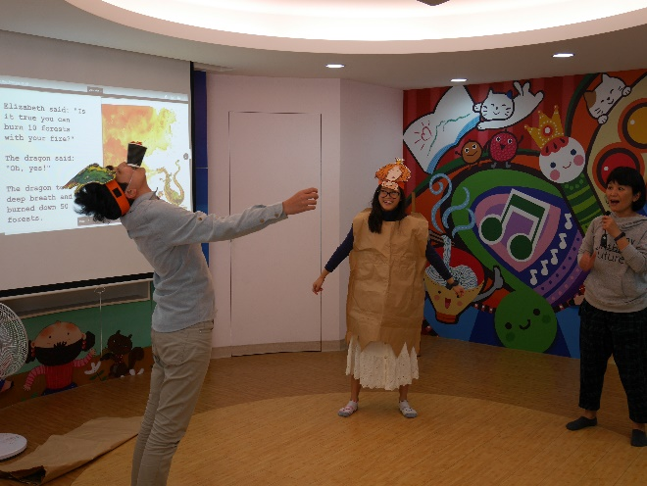
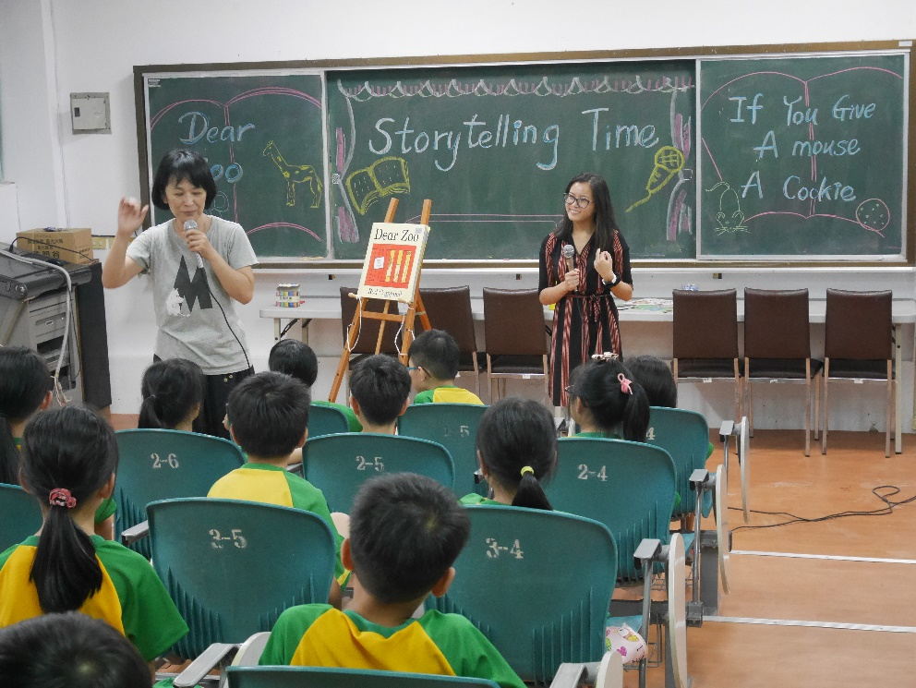
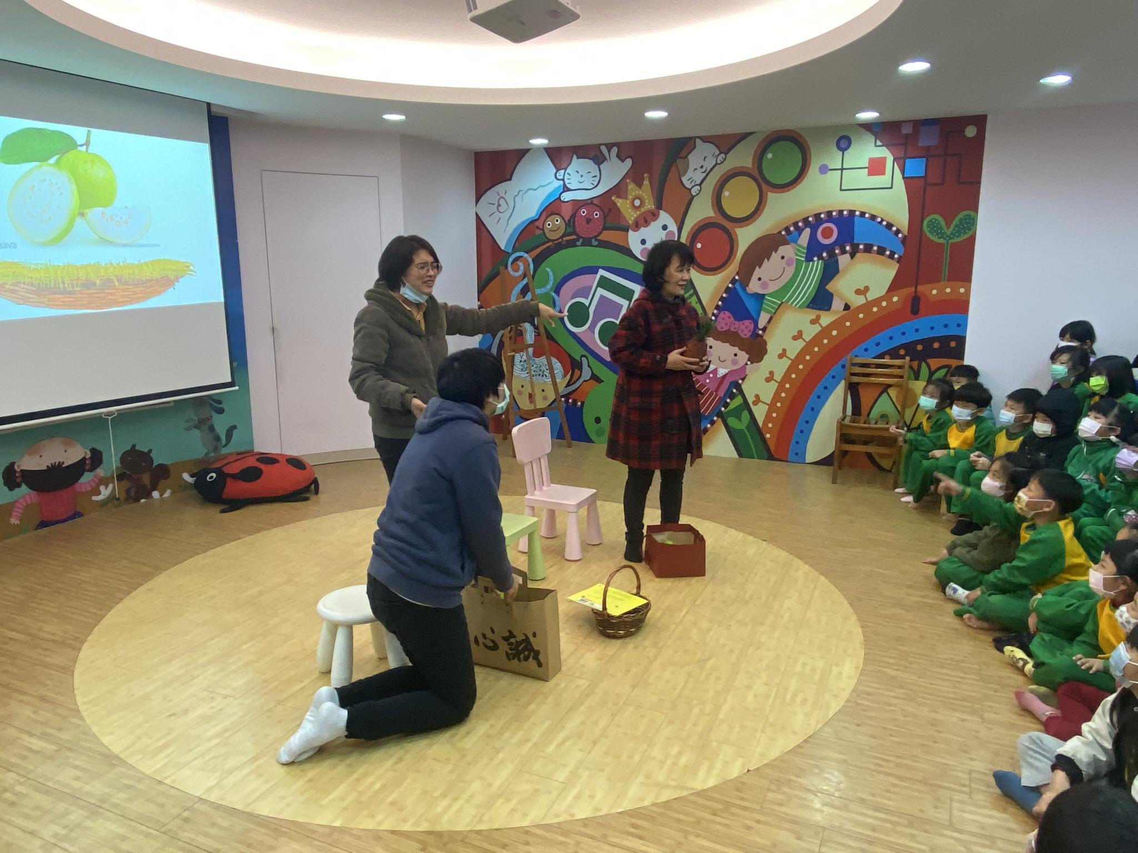
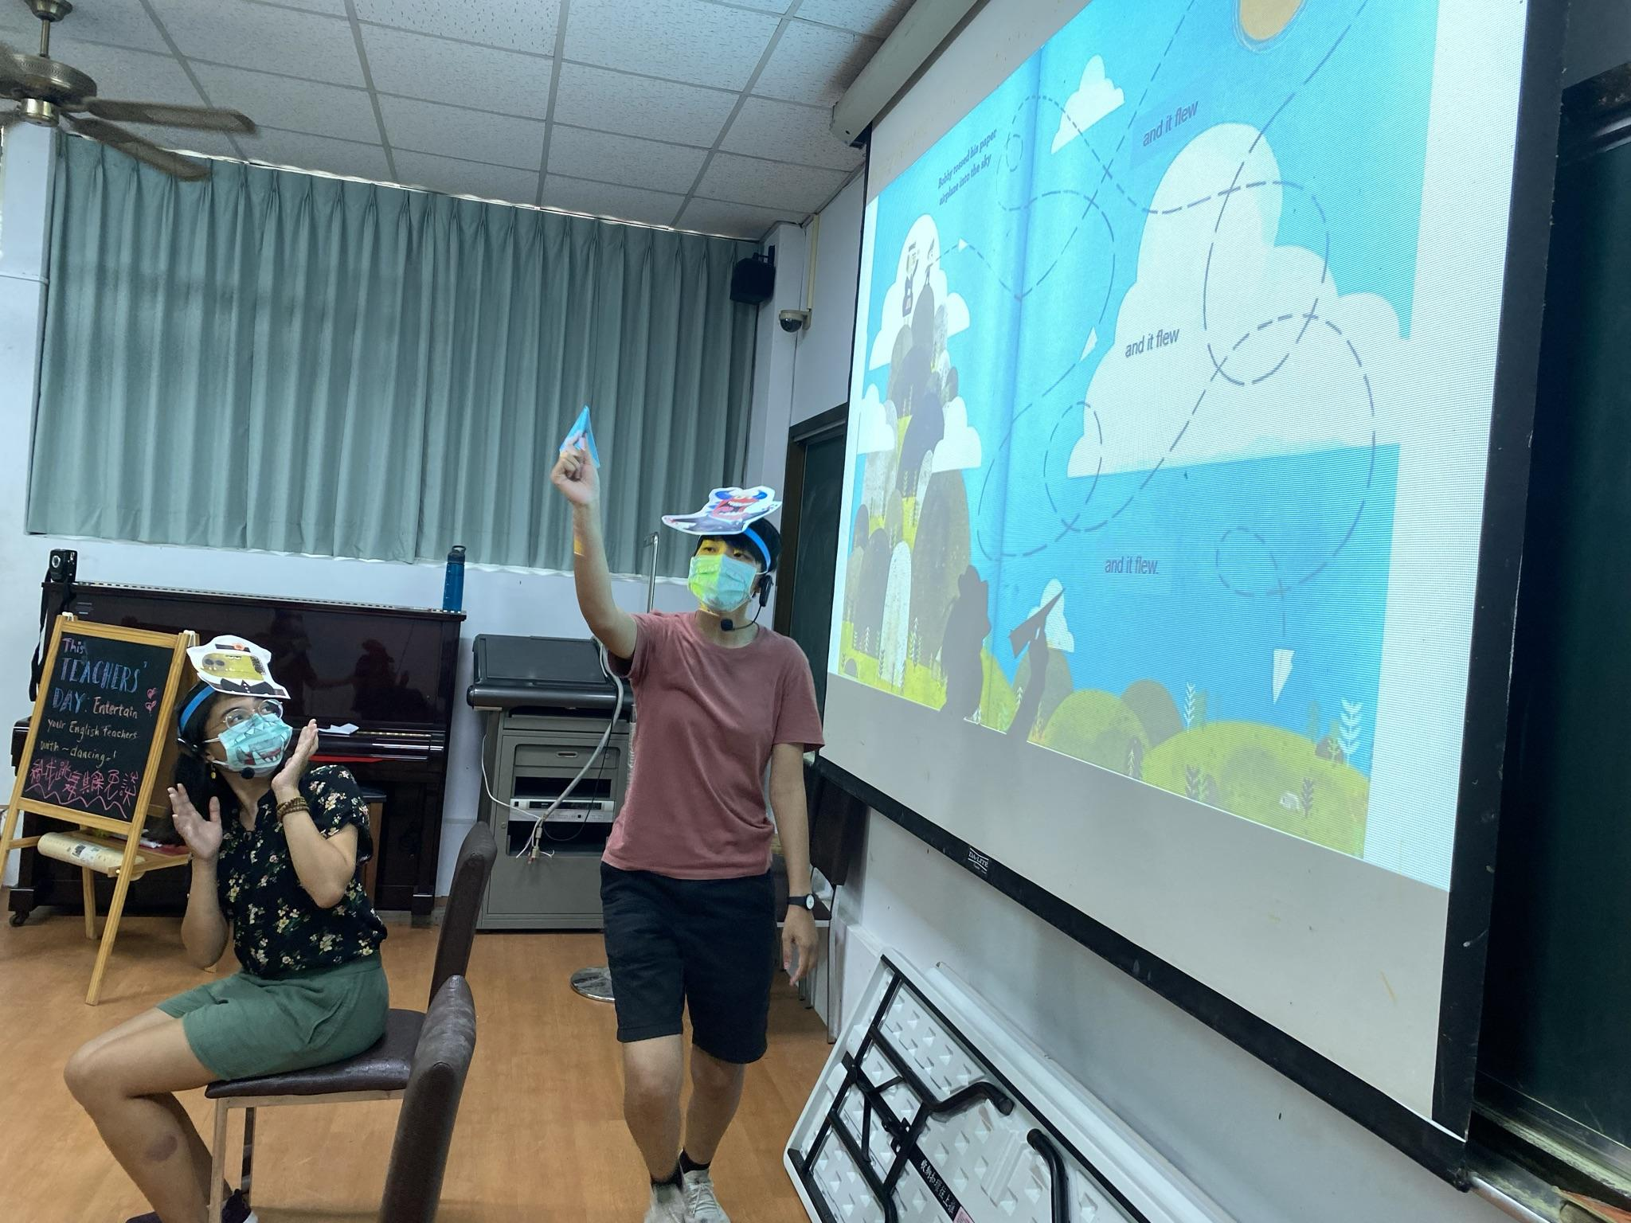
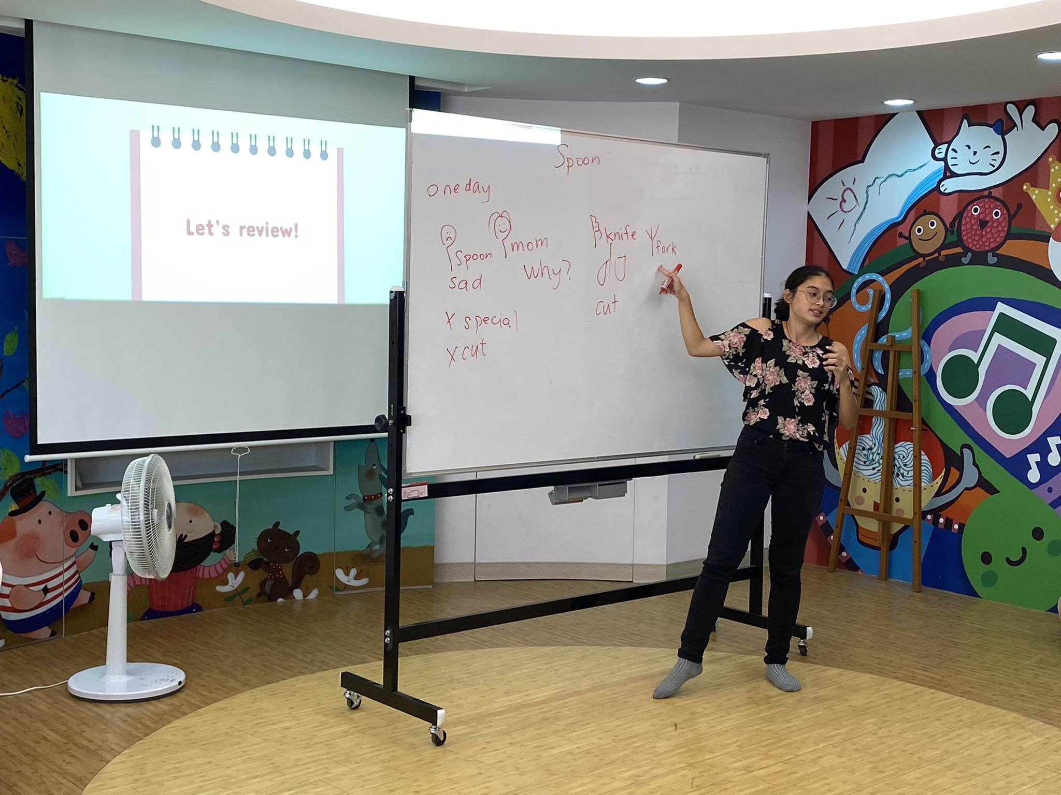
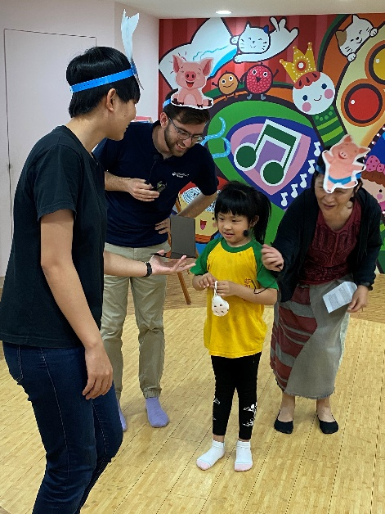
Storytelling
the Paper Bag Princess
Dear Zoo/ If You Give a Mouse a Cookie
Handa's Surprise
My teacher is a Monster
I Like Me
Spoon

Slide 15
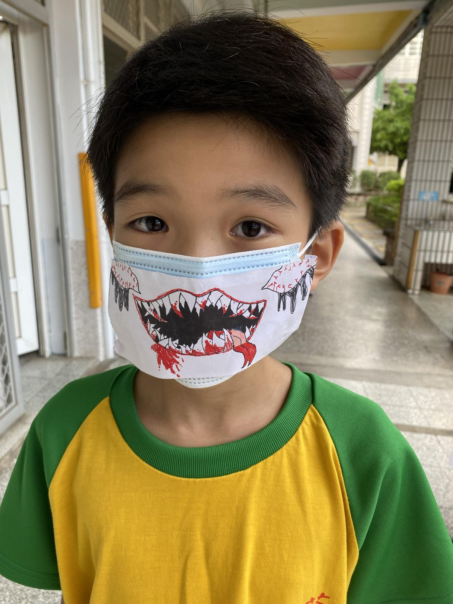
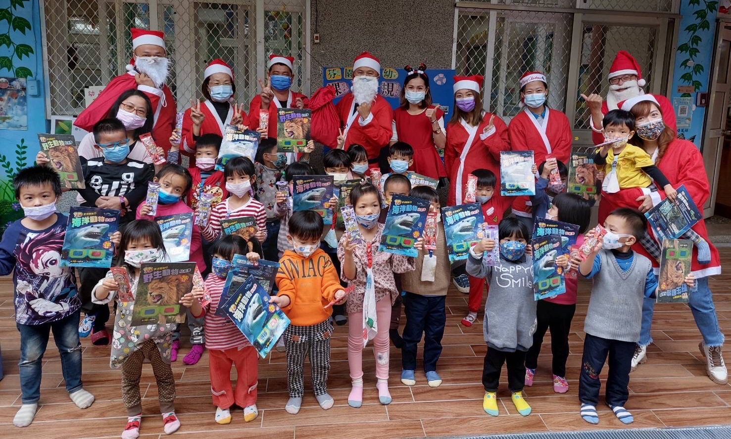
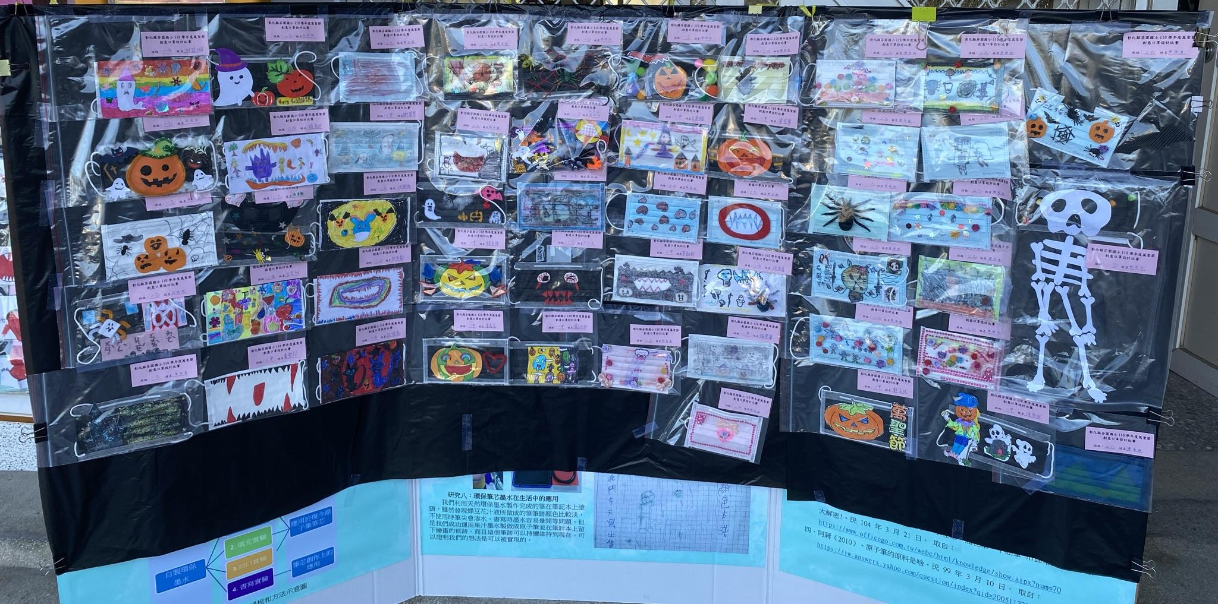
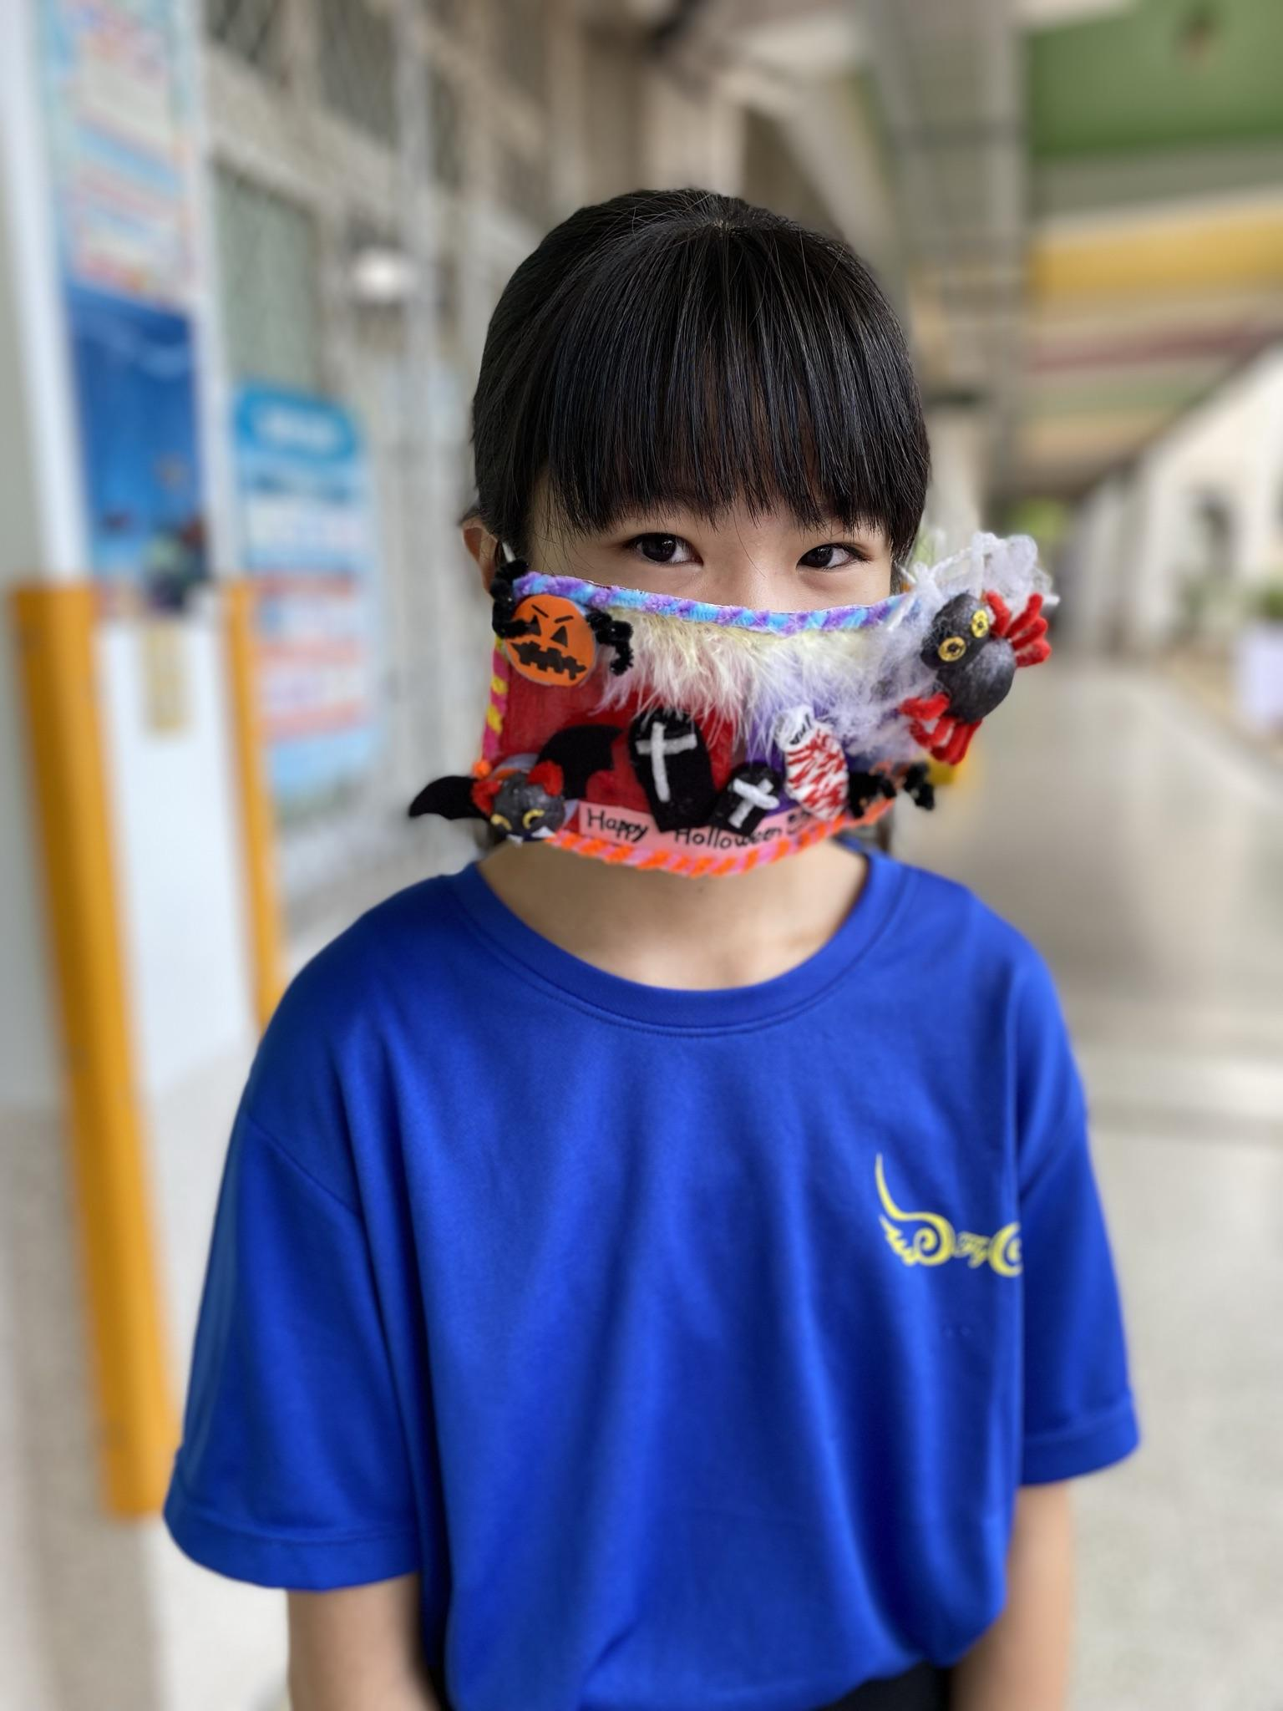
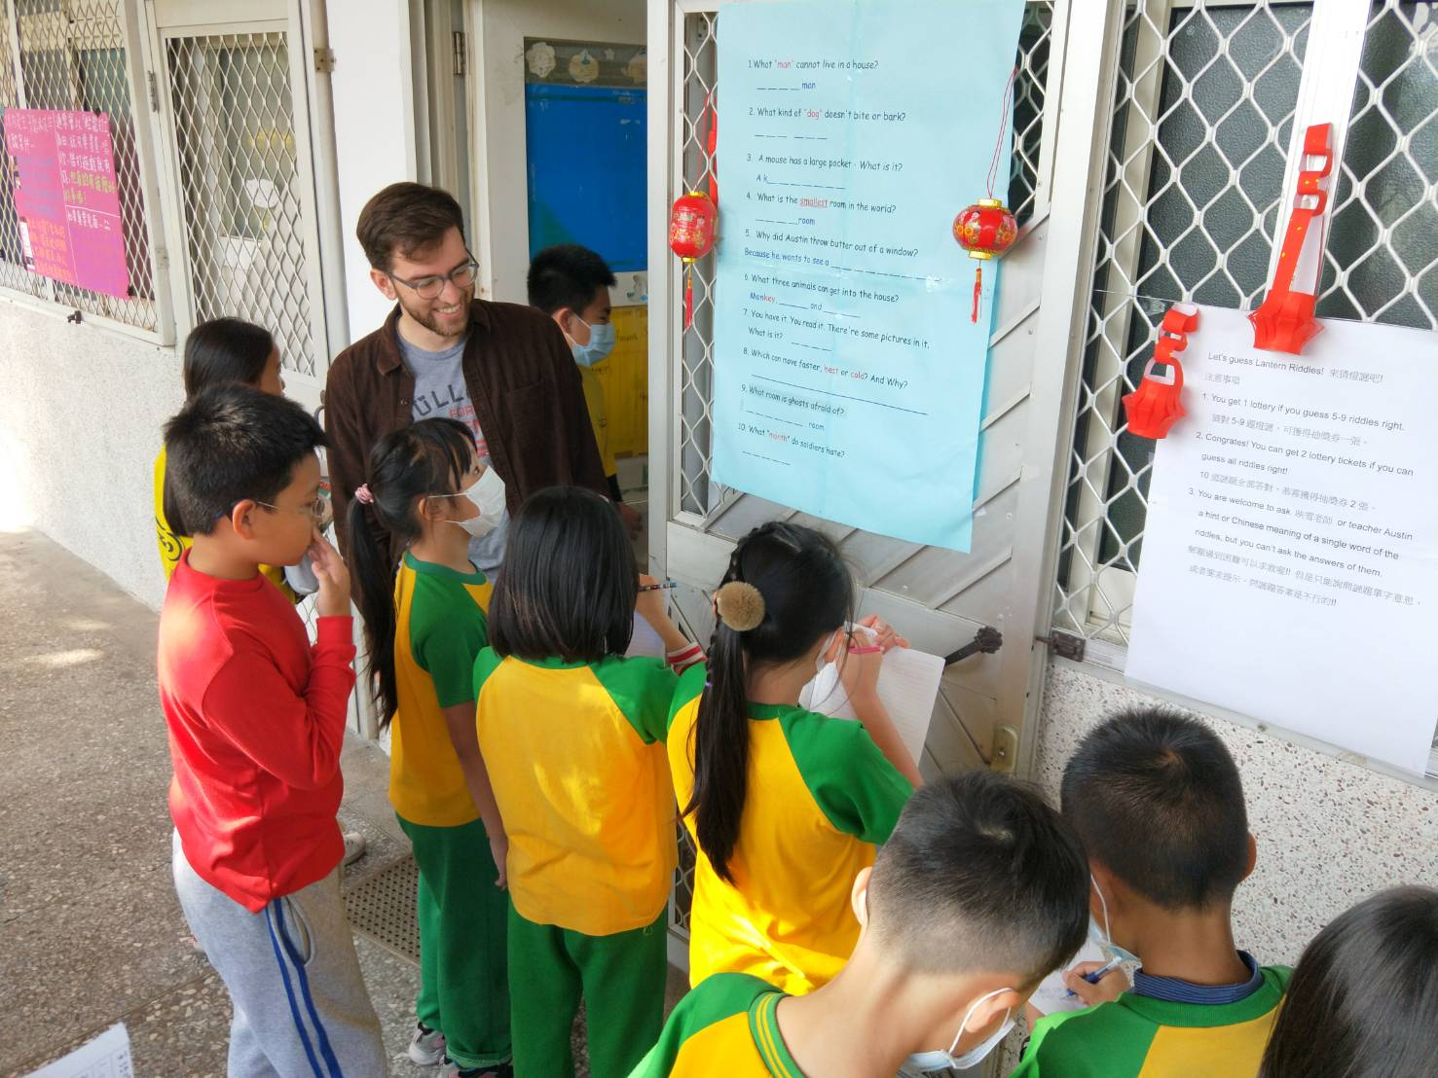
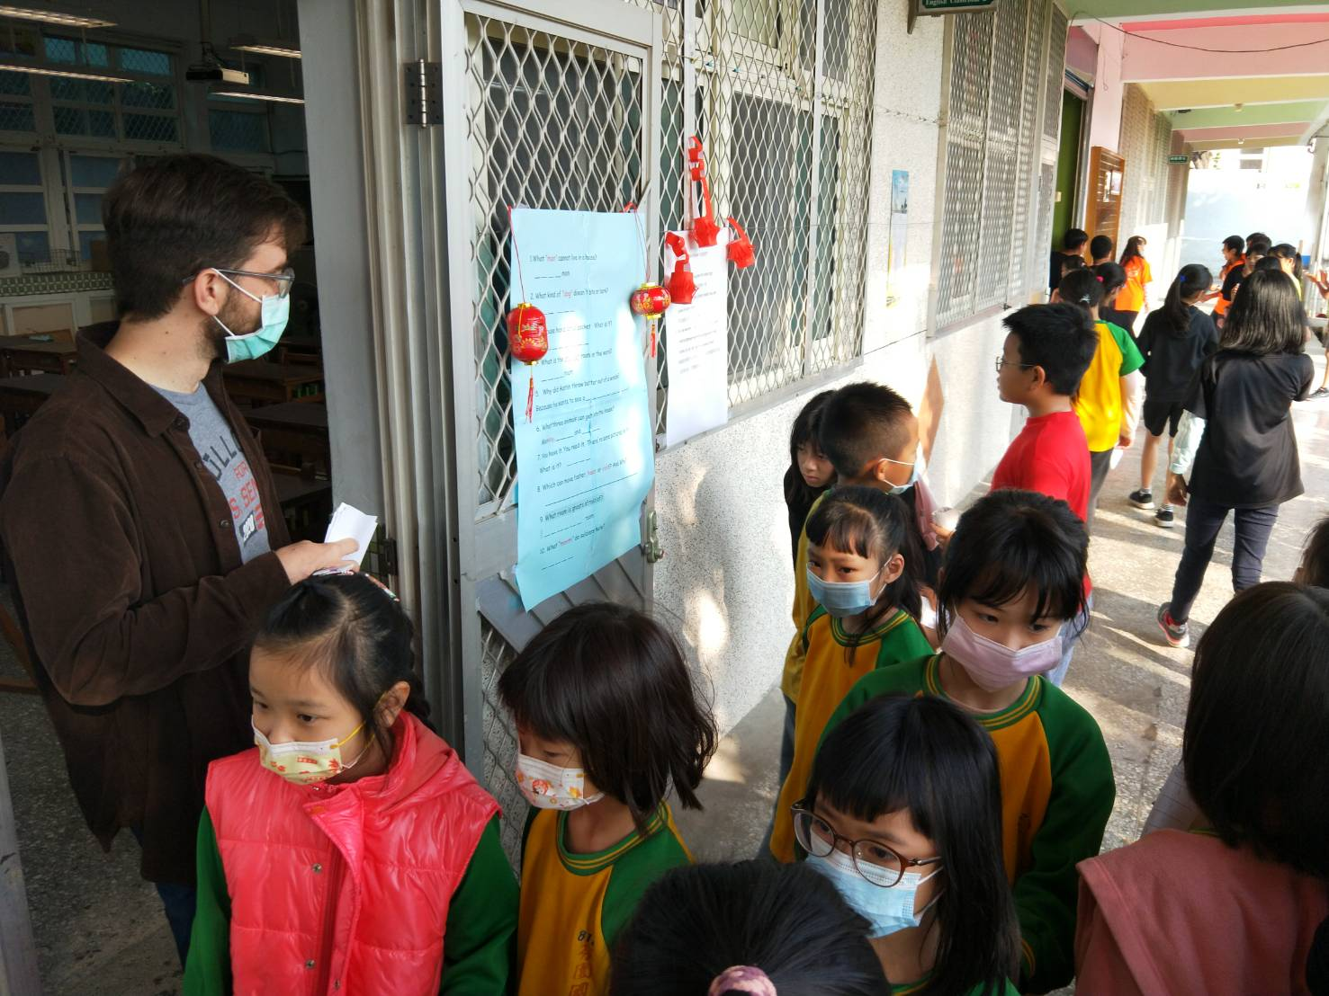
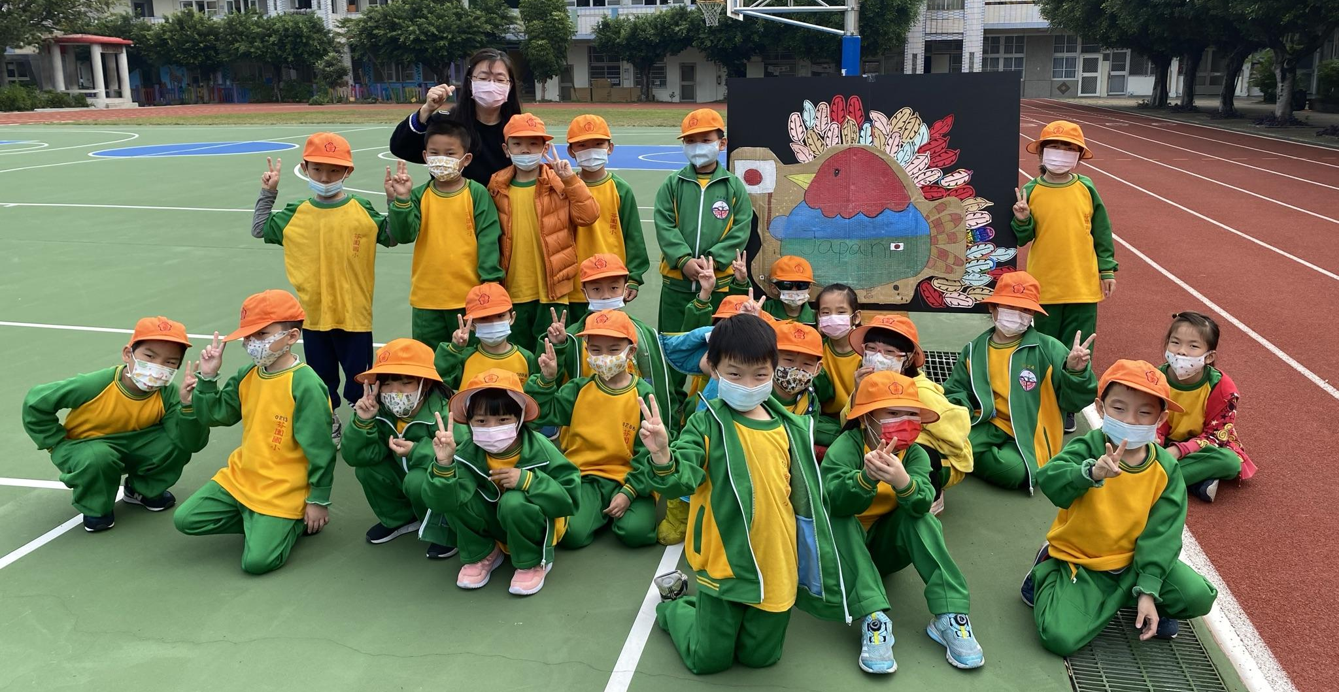
Festivals Activities
Christmas
Halloween
Thanksgiving
Lantern Festival (Riddles Guessing)

Slide 16
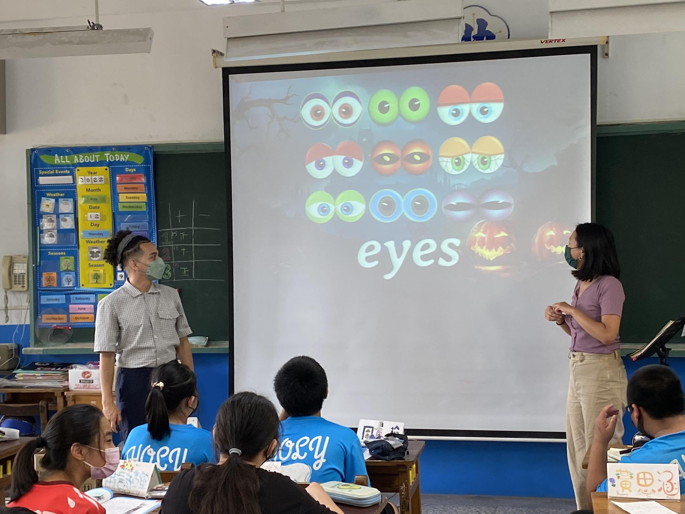
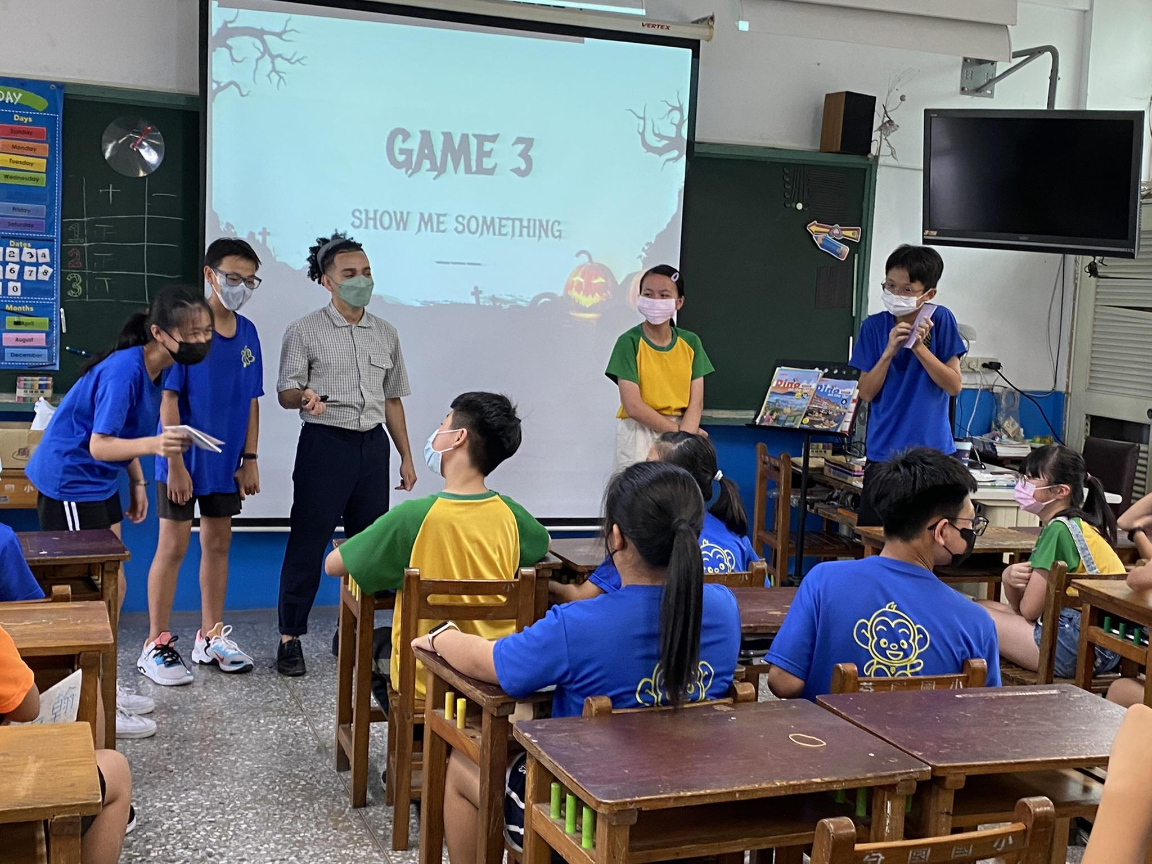
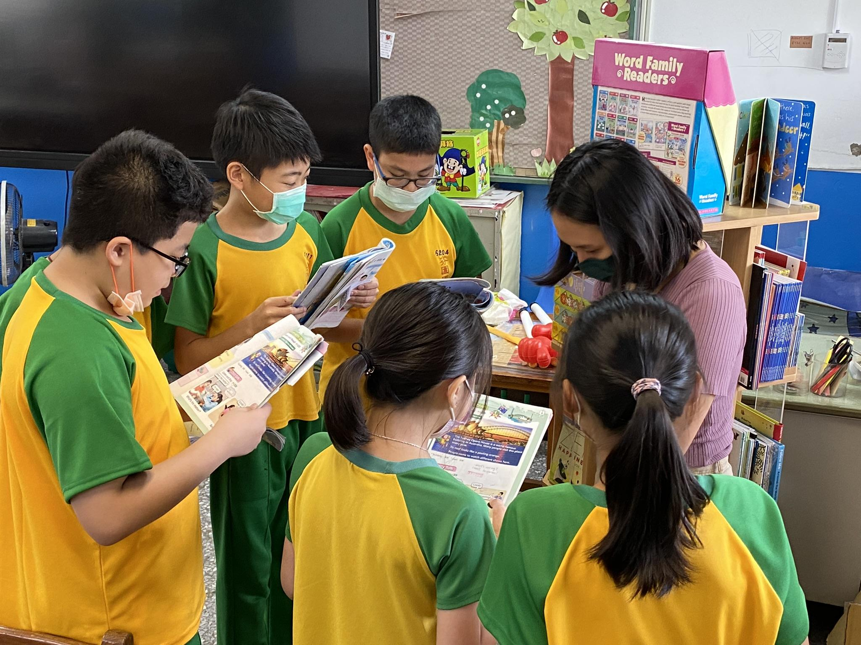
ETF on the go

Slide 17
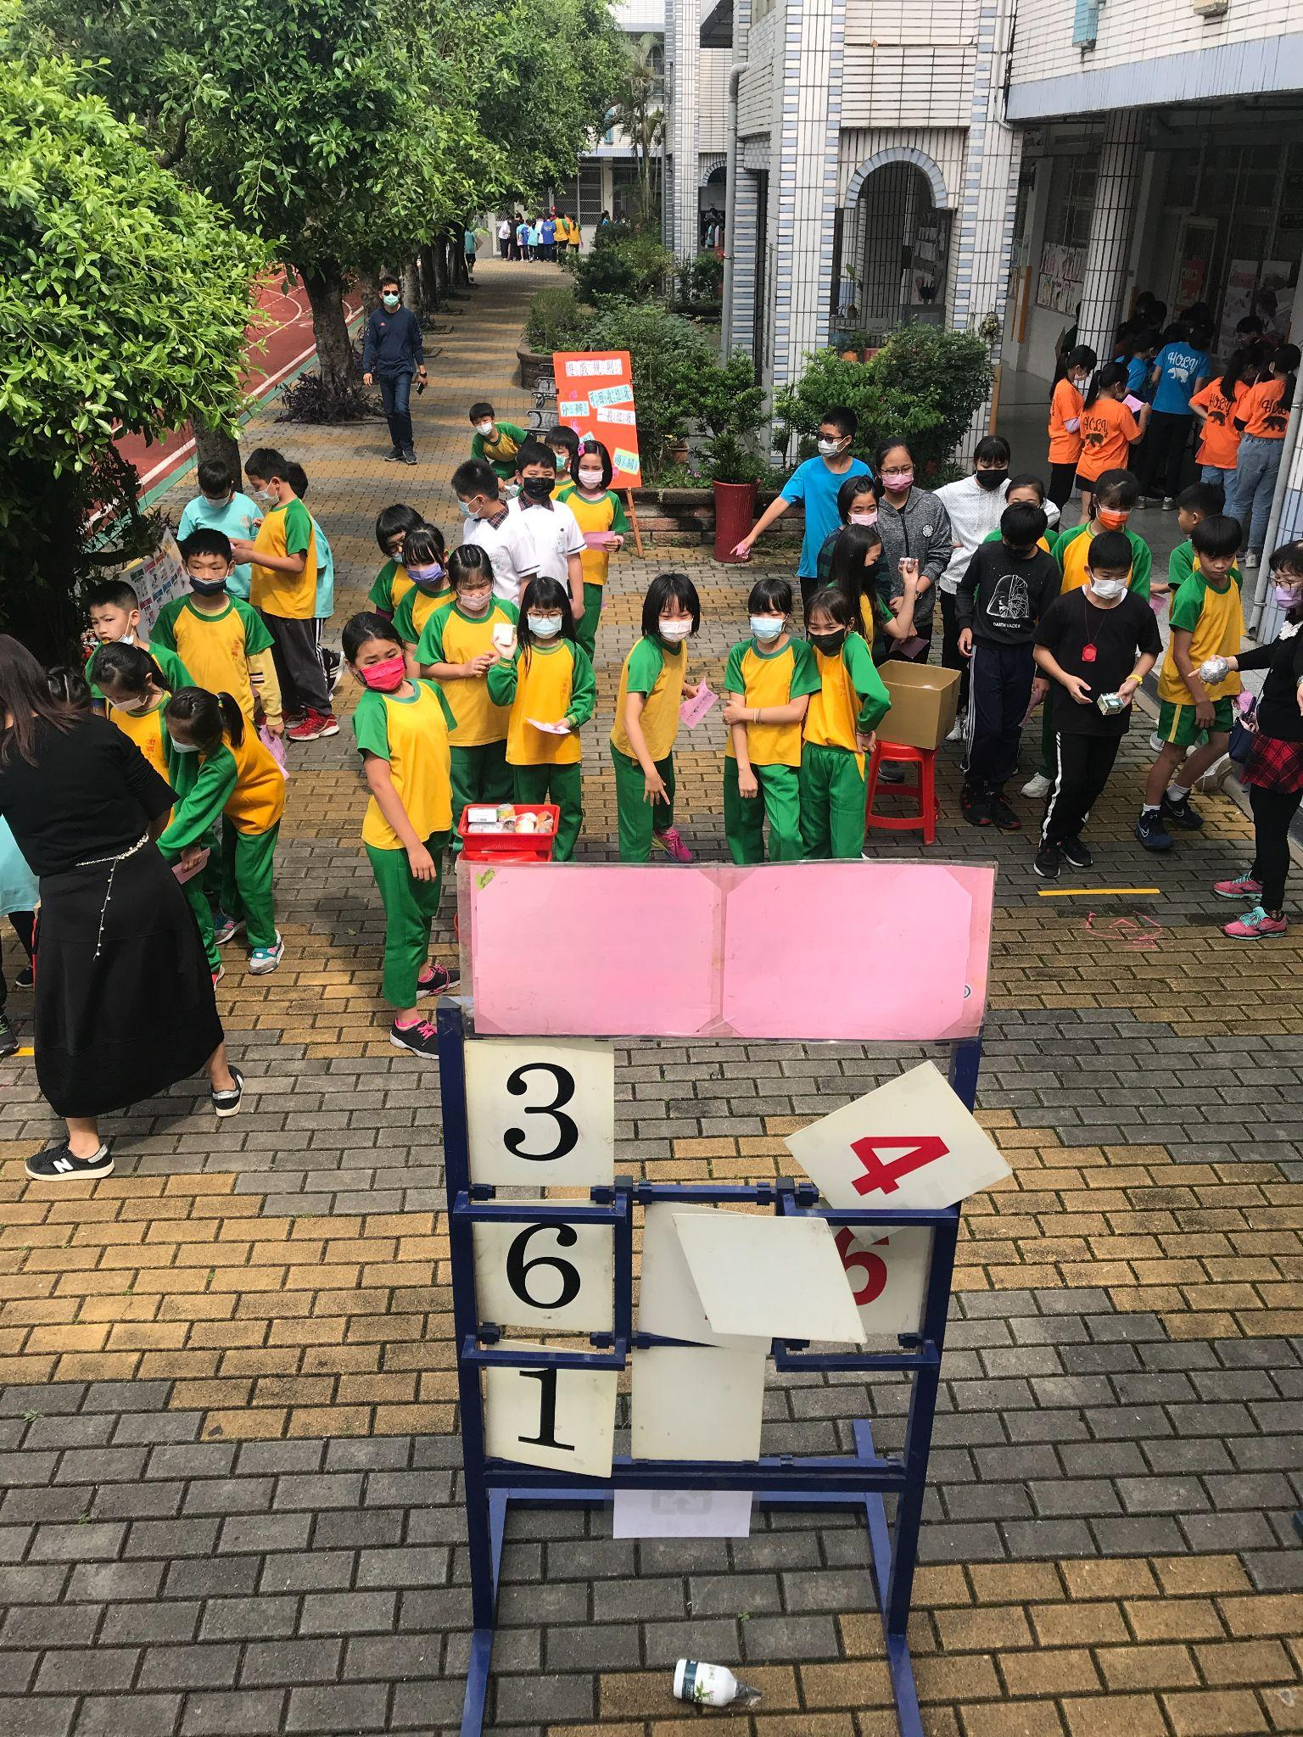
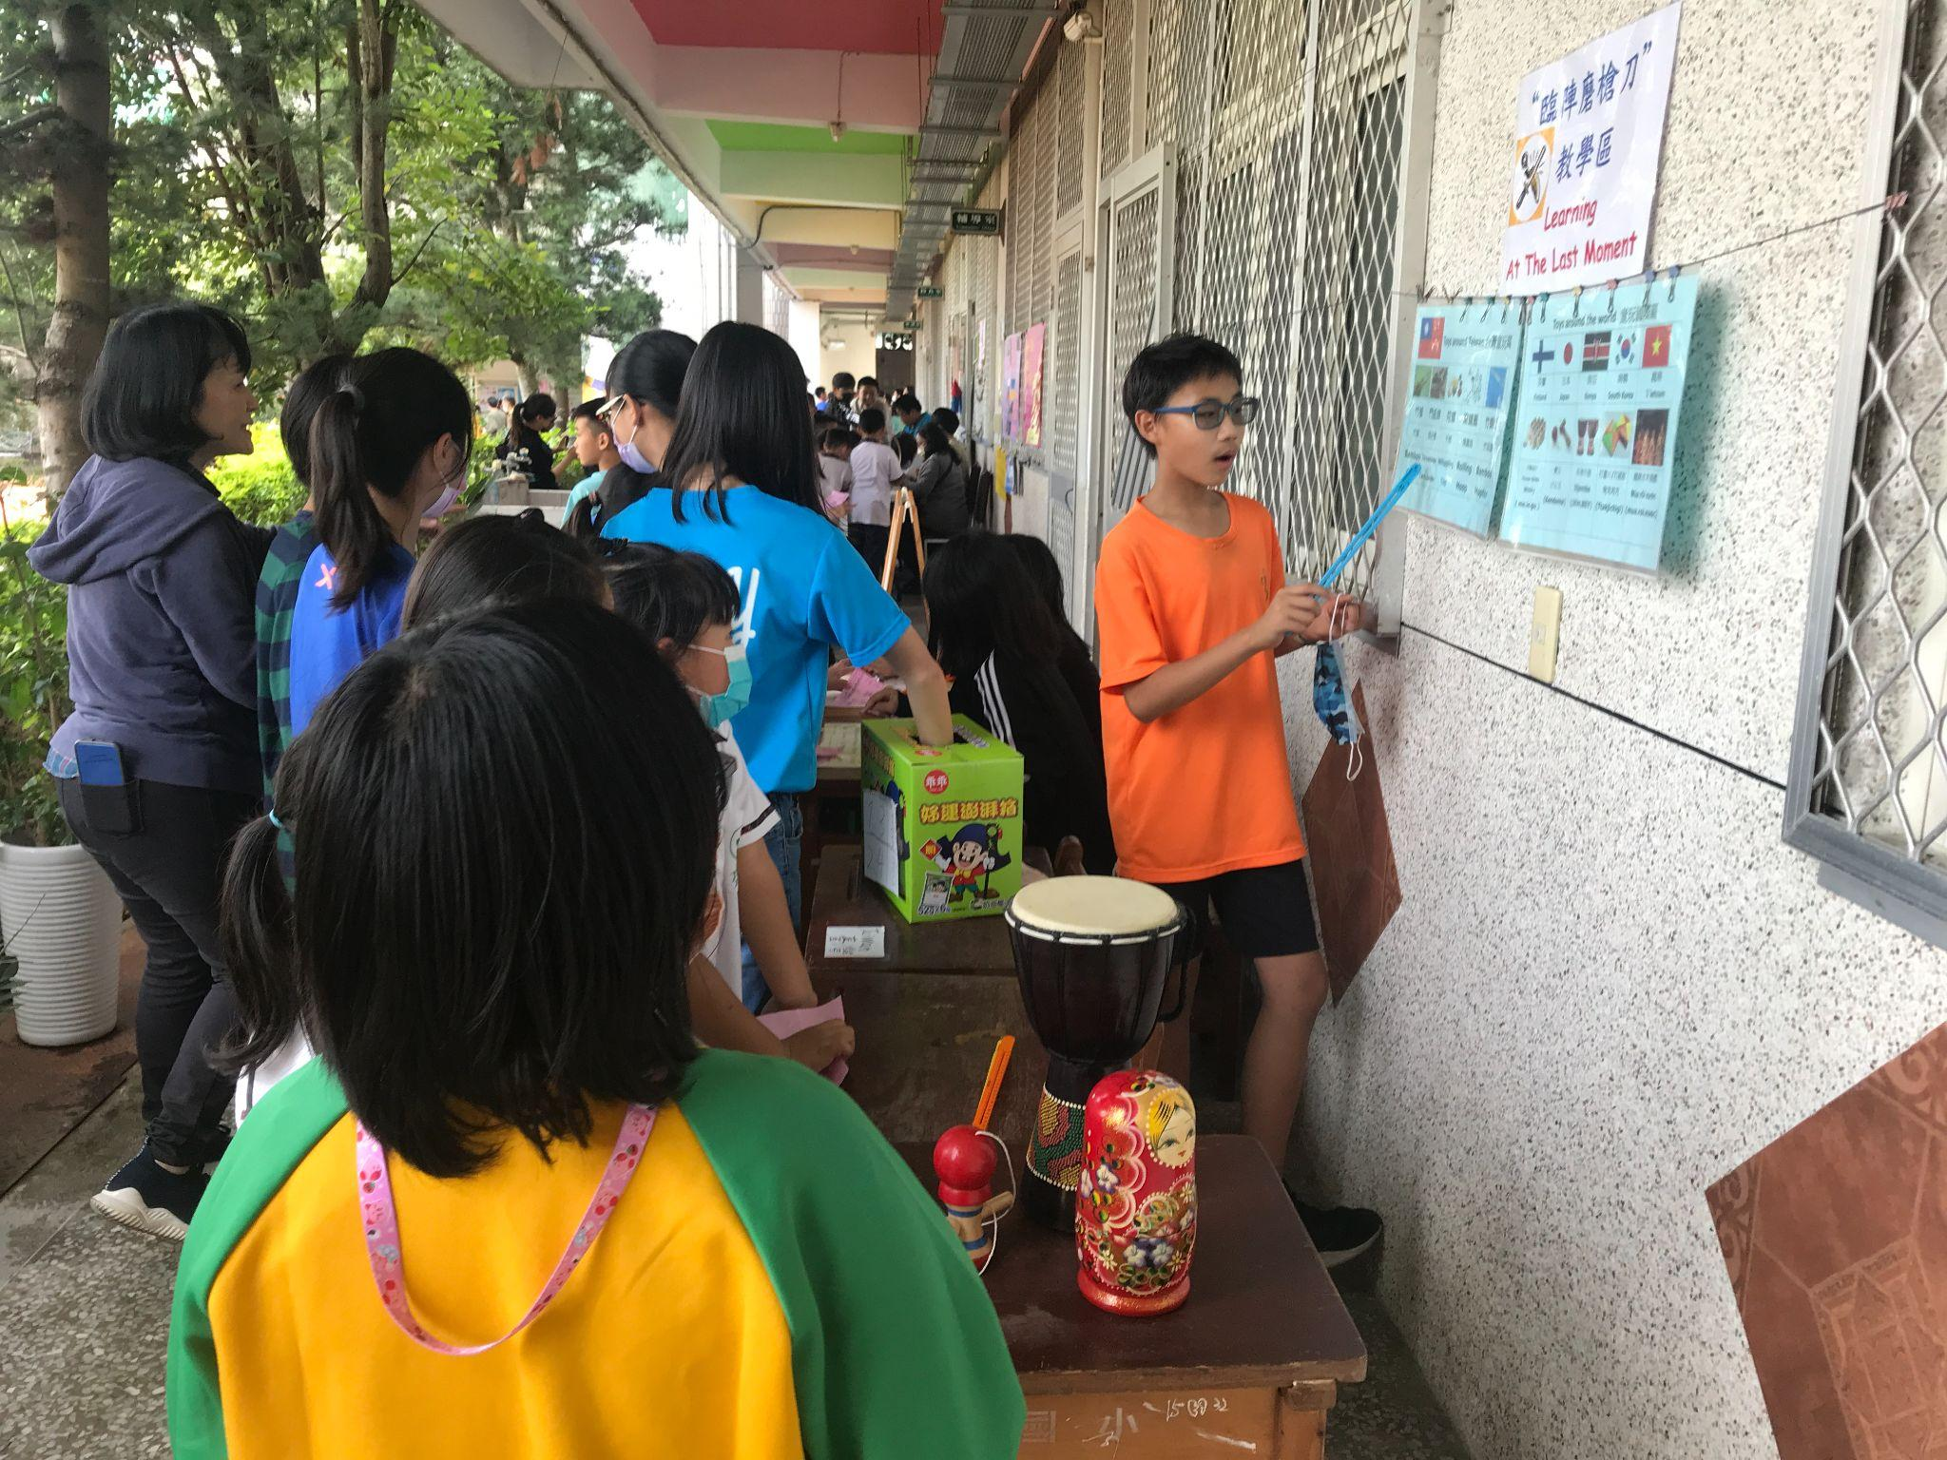
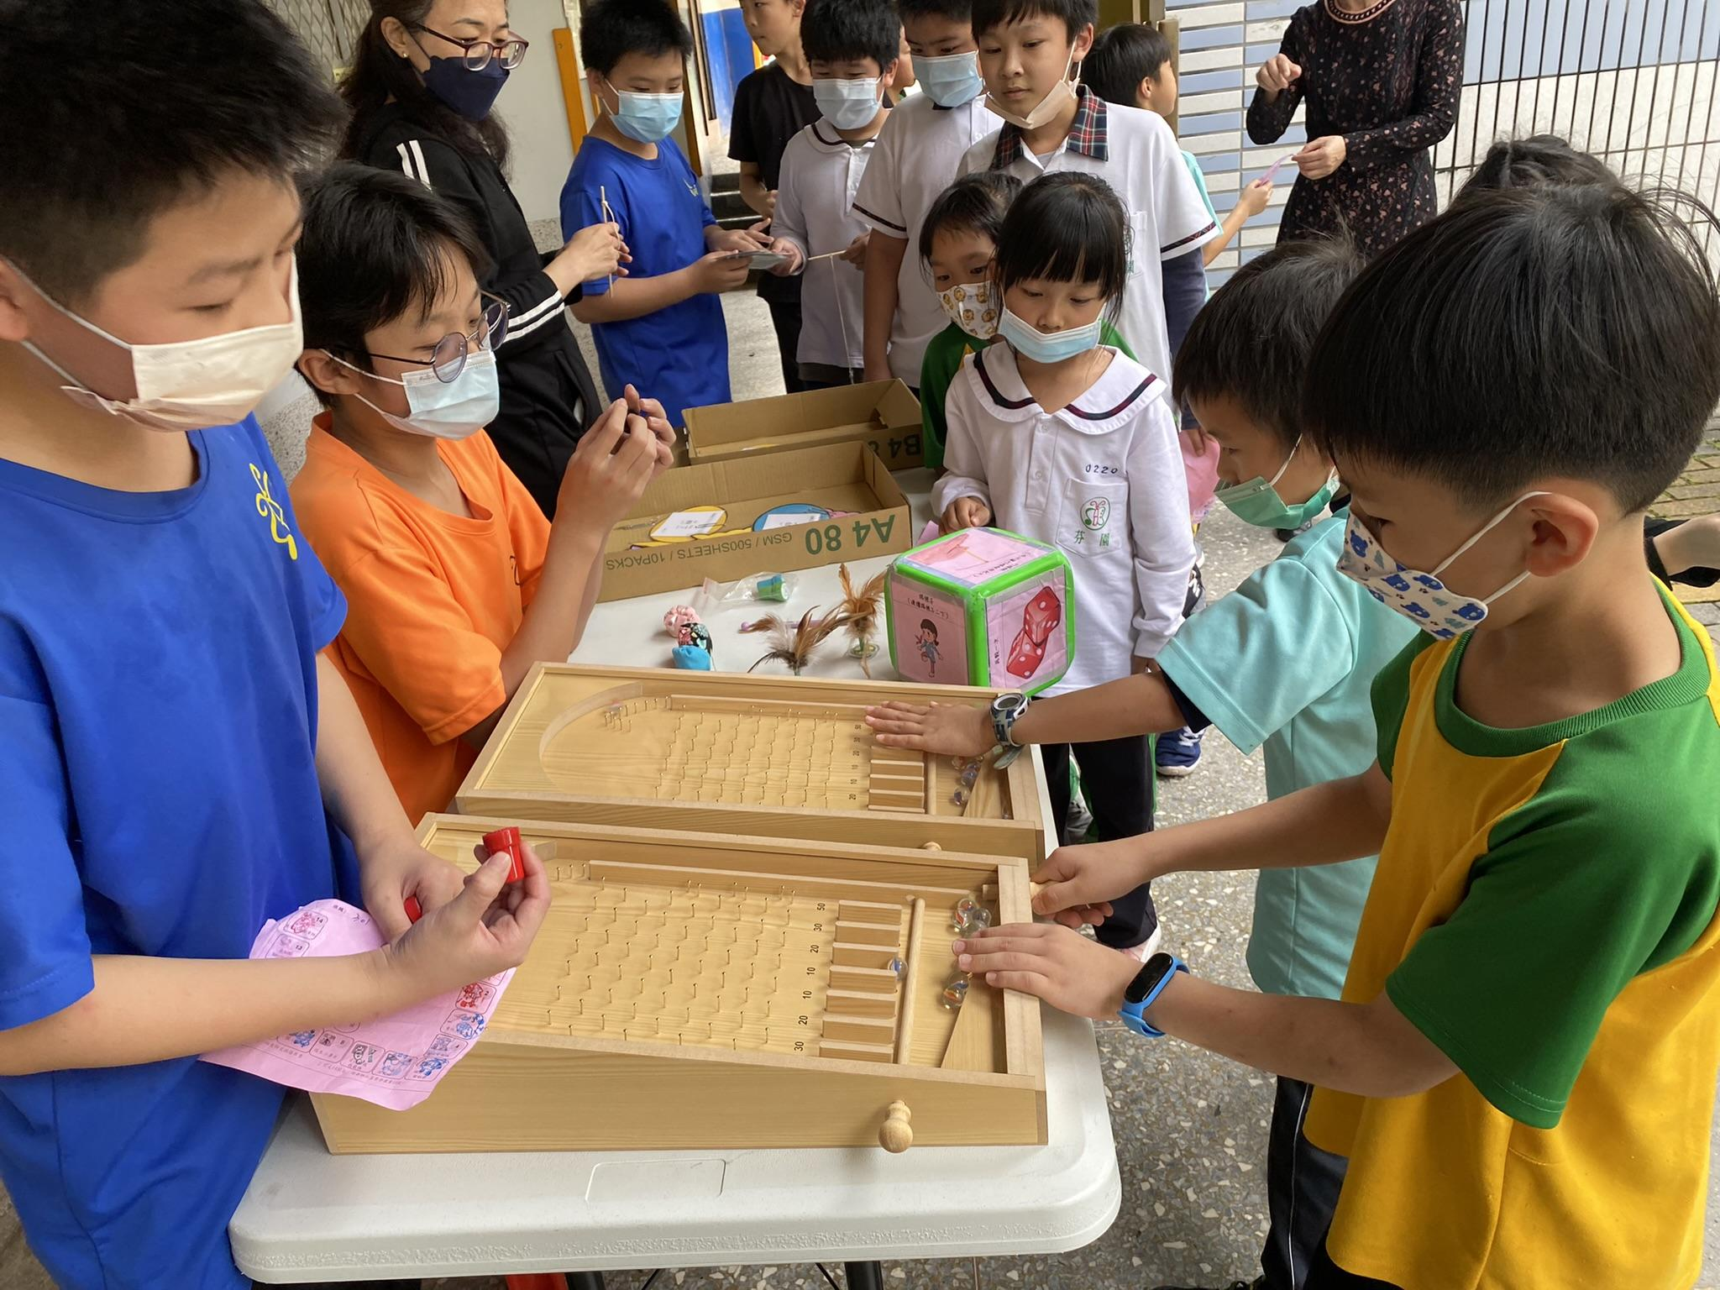
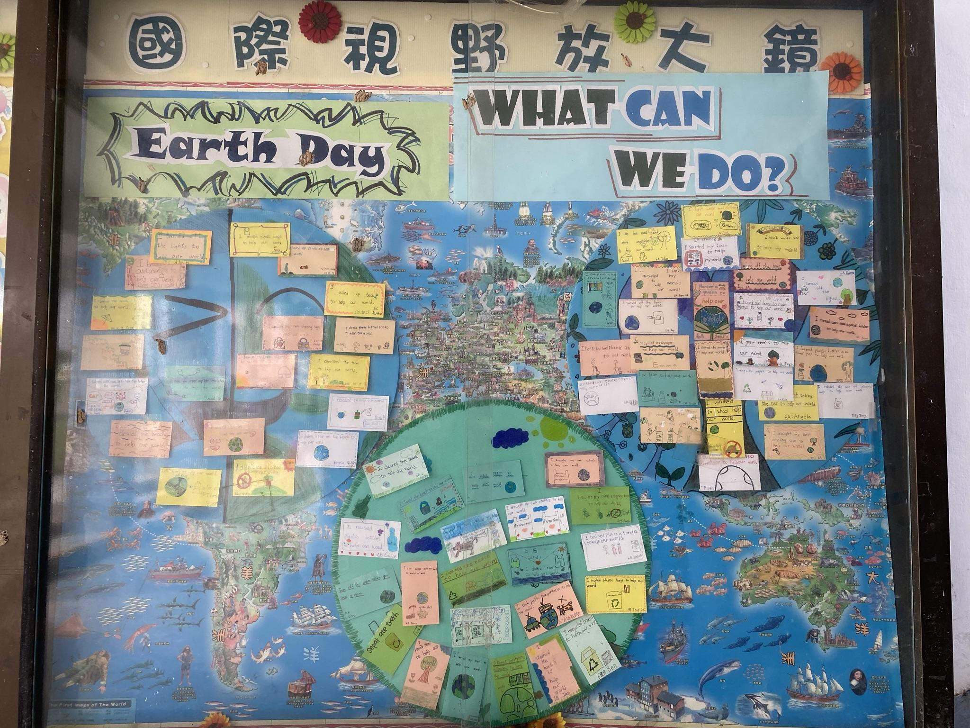
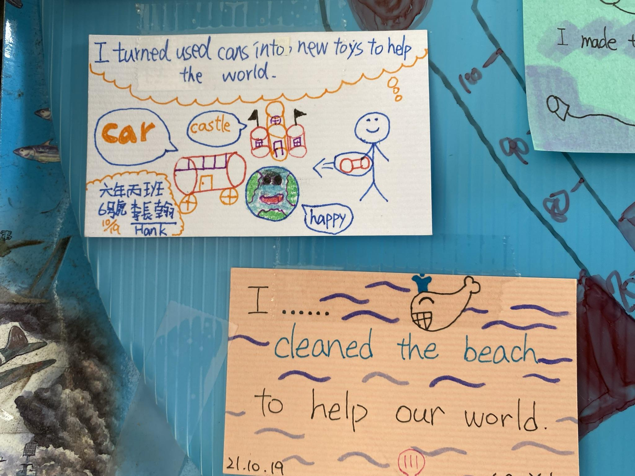
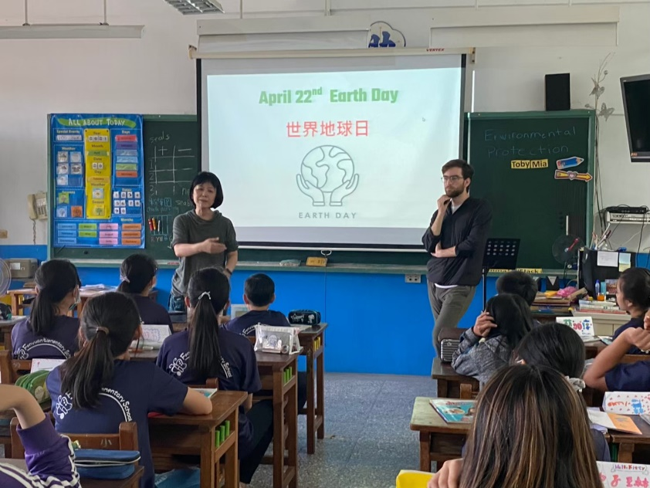
Children’s Day Activities
Earth Day

Slide 18
Contact window
Karen Chung
The Director of Academic Department of FYPS
Email:naipaul0419@gmail.com
Yinhsueh Chiang
English Teacher / Program Executive Teacher
Email: g9641229@gmail.com
No. 48, Ln. 27, Sec. 4, Zhangnan Rd., Fenyuan Township, Changhua County 502 , Taiwan (R.O.C.)
Phone: +886-49-2522208
Fax : +886-49-2521438

